Slide 1
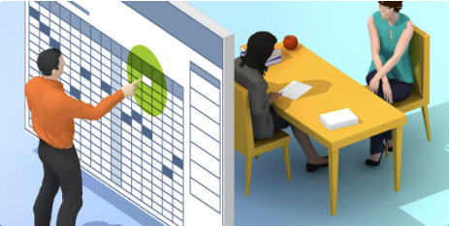
Overview of the Conference Manager for Teachers

Slide 2
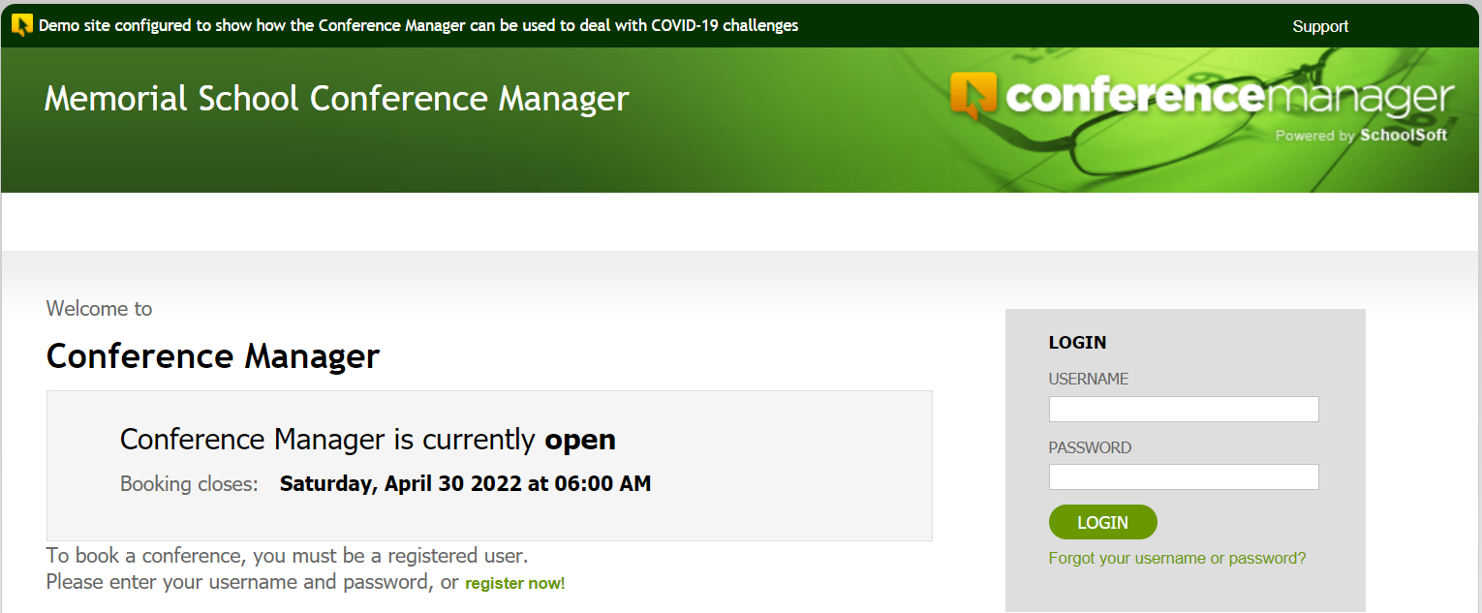
Access the Conference Manager
Enter the school’s URL for the Conference Manager staff log-in page
Notes:
Teachers have to go to the application URL to log in. It is important that all teachers confirm they can log in well before conferences begin. You might want to ask everyone to do this within a day of your meeting.

Slide 3
Login credentials
Your password was sent to you in an email from
appointments@schoolsoft.com
From: appointments@schoolsoft.com
Sent: September 4, 2021 2:40 PM
To: Ima Teacher iteacher@schooldistrict.edu
Subject: Schoolsoft Conference Manager – New Account
Hello Ima,
Heather Fox has set up your staff account for the SchoolSoft Conference Manager.
You can access the application at https://memorial.schoolsoft.com/login.jsf.
Login in using your username iteacher and password $7hY%hAm
Thanks you for using the SchoolSoft Conference Manager.

Slide 4
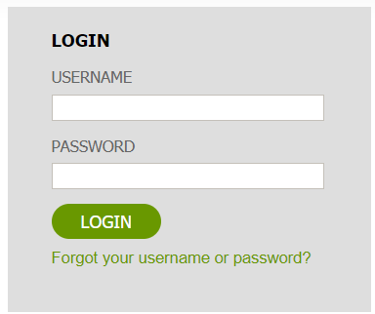
Forgot or can’t find your password?
Click the Forgot Password link on
the log-in page to reset it.

Slide 5
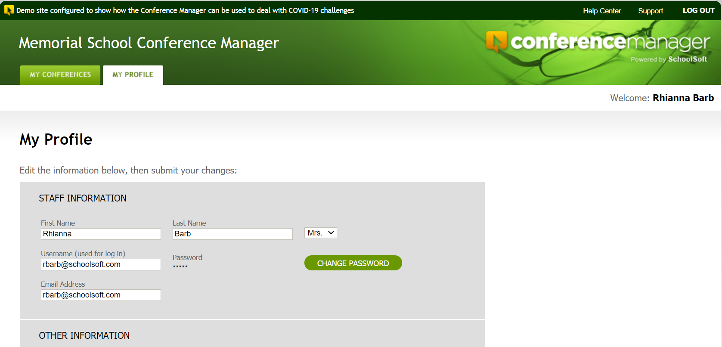
Your profile is where you can enter information relating to you, your account, note to parents booking and the online meeting URL that you will be using for your virtual conferences.
Notes:
The profile should be double checked by all teachers before conference bookings begin to ensure the teaching assignment, conference location and other information is accurate.

Slide 6
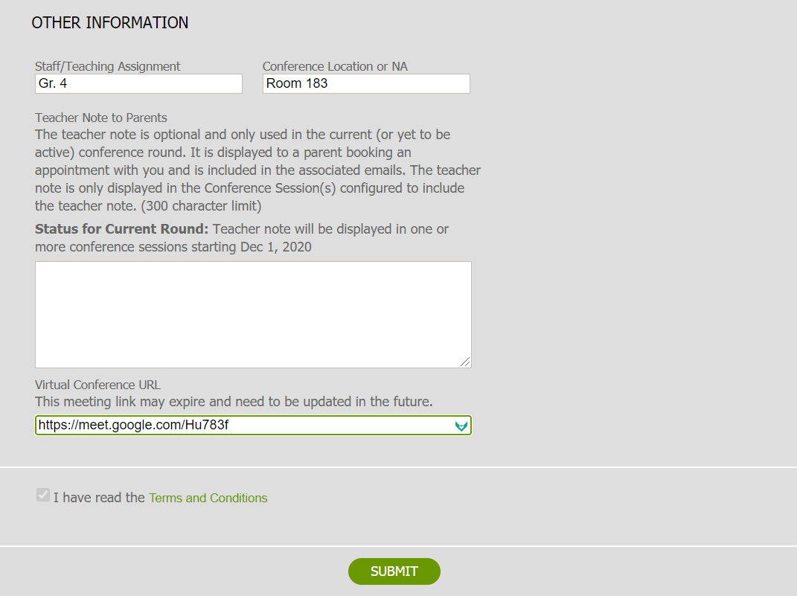
With virtual conferences your physical conference location is not displayed.
Depending upon the school’s configuration of conferences, you may be able to have a message sent to all parents who will or have booked a conference with you.
If virtual conferences are being conducted the will need to create an online meeting using the school’s online meeting application and enter the URL so it can be shared with parents who book a conference.
Notes:
The can also include a note to parents who have or will be booking a teacher. This is useful if the teacher wants to provide a specific message that pertains only to a parent making a booking with the teacher. This message is sent as an updated conference confirmation form. The virtual conference URL is only accessed from the teacher profile if the school opts to do virtual conferences.

Slide 7
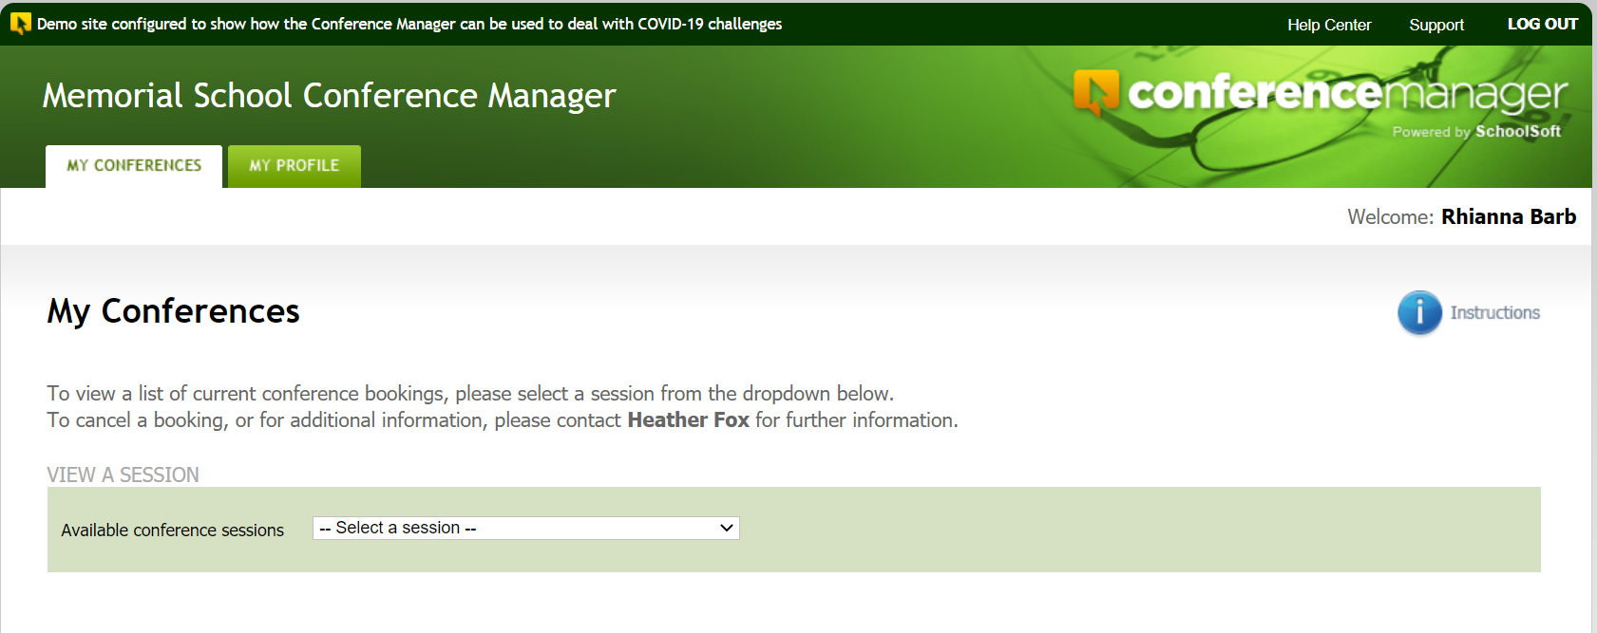
The MY CONFERENCES tab lets you access your schedule
Access to help resources
Quick start guide
Notes:
Once logged in you can access the help center and a quick start guide.

Slide 8
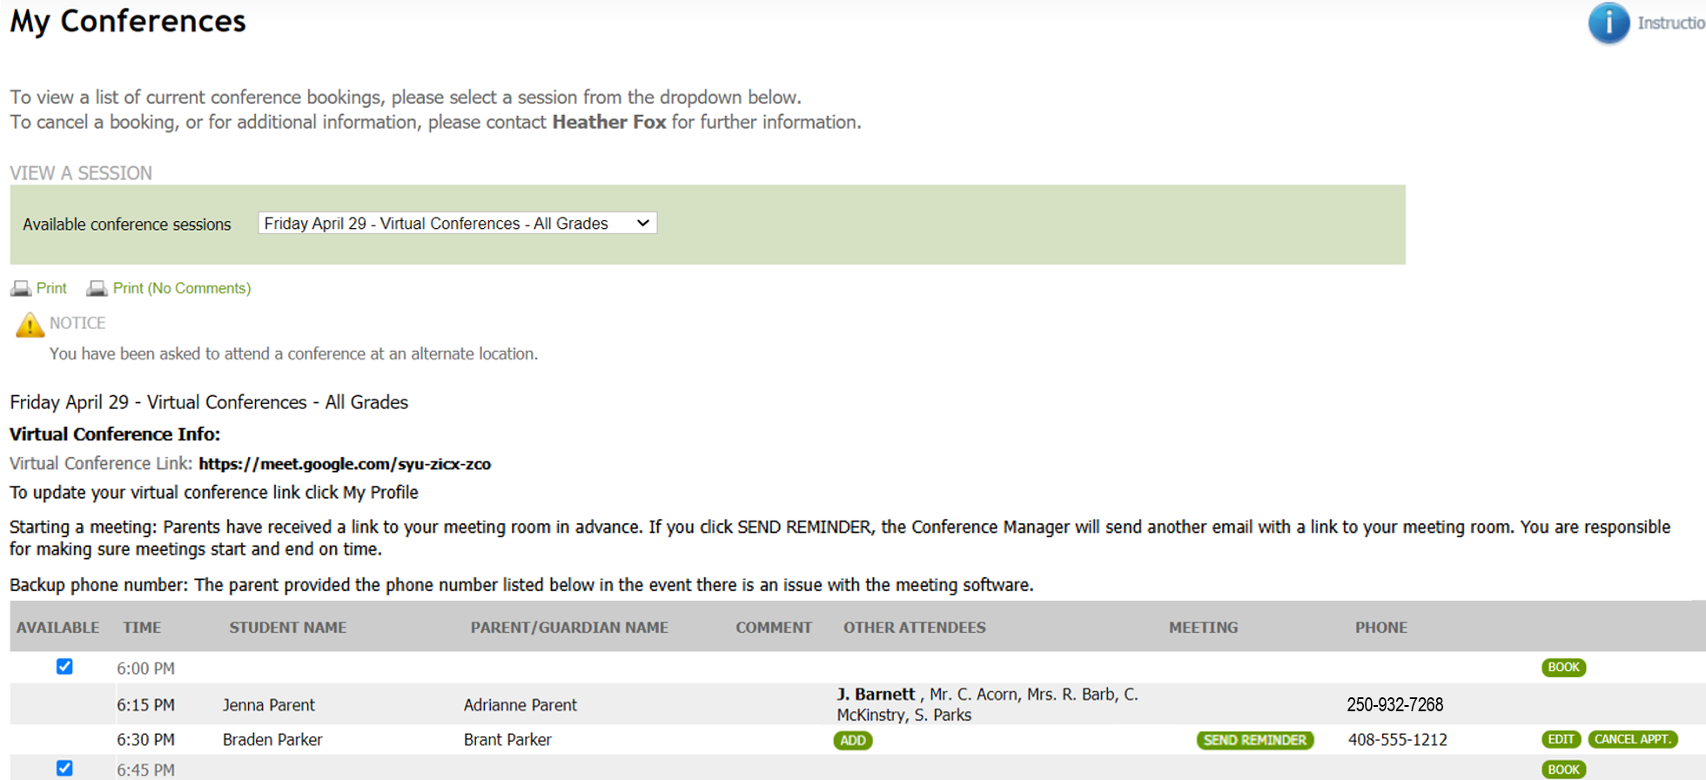
Rhianna Barb
Drop-down list allows you to select a schedule to view
Notes:
The teachers starts by selecting the desired schedule from the drop down list of all conference schedules.

Slide 9
Rhianna Barb
Print schedule
Notes:
A hard copy can be printed if desired by the teacher.

Slide 10

Rhianna Barb
Use BOOK button only if you are booking an appointment for a parent. This button may not be displayed if teachers do not book appointments.
The school can configure conferences so the teacher
can remove the check to make a time slot unavailable
Notes:
If there is a comment or question the teacher entered, then the comment icon.

Slide 11
Rhianna Barb
A teacher can invite other available staff, such as an interpreter, to a specific conference using the ADD button
When additional staff are invited to a meeting, they appear here. The initiating teacher is in bold, others are invitees.

Slide 12
Rhianna Barb
In most cases parents will already have used the online meeting application link sent in their confirmation email and be waiting for the teacher to admit them to the meeting. However, if the parent is not waiting online, the teacher can click the SEND REMINDER button to send an email informing the parent the meeting is ready to begin.
The teacher’s virtual conference link in their profile is displayed here.
Notes:
In most cases the teachers will not need to use these buttons, but it is important to point them out.

Slide 13
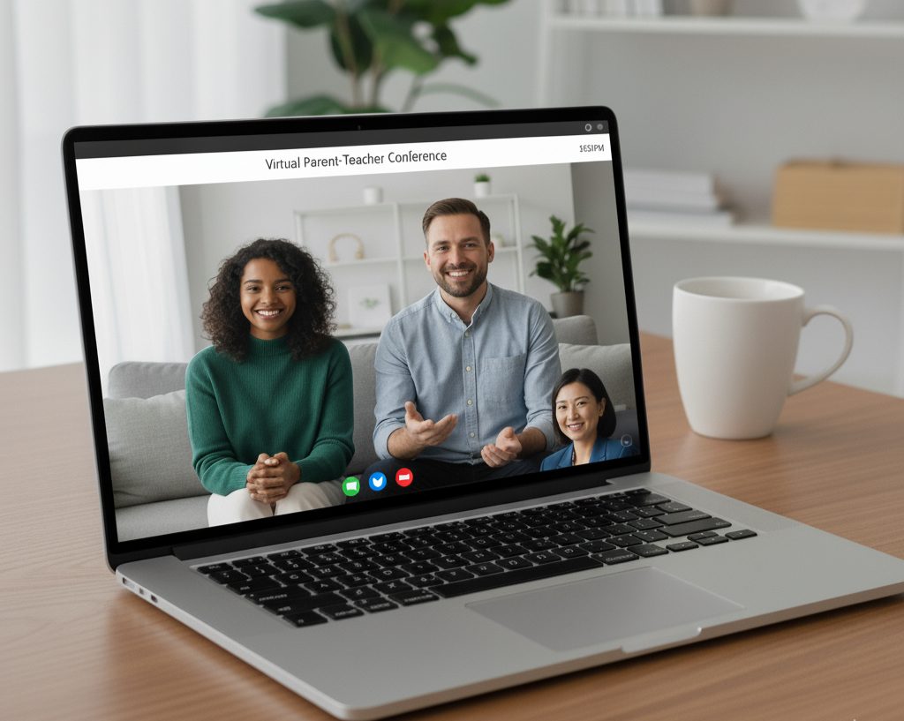
Teachers use the school’s online meeting platform to manage the admission of scheduled parents to the online conference. Keeping the Conference Manager open in a browser tab makes it easy to reference which parents they will be meeting with next.

Slide 14
Log out when exiting

